Slide 1
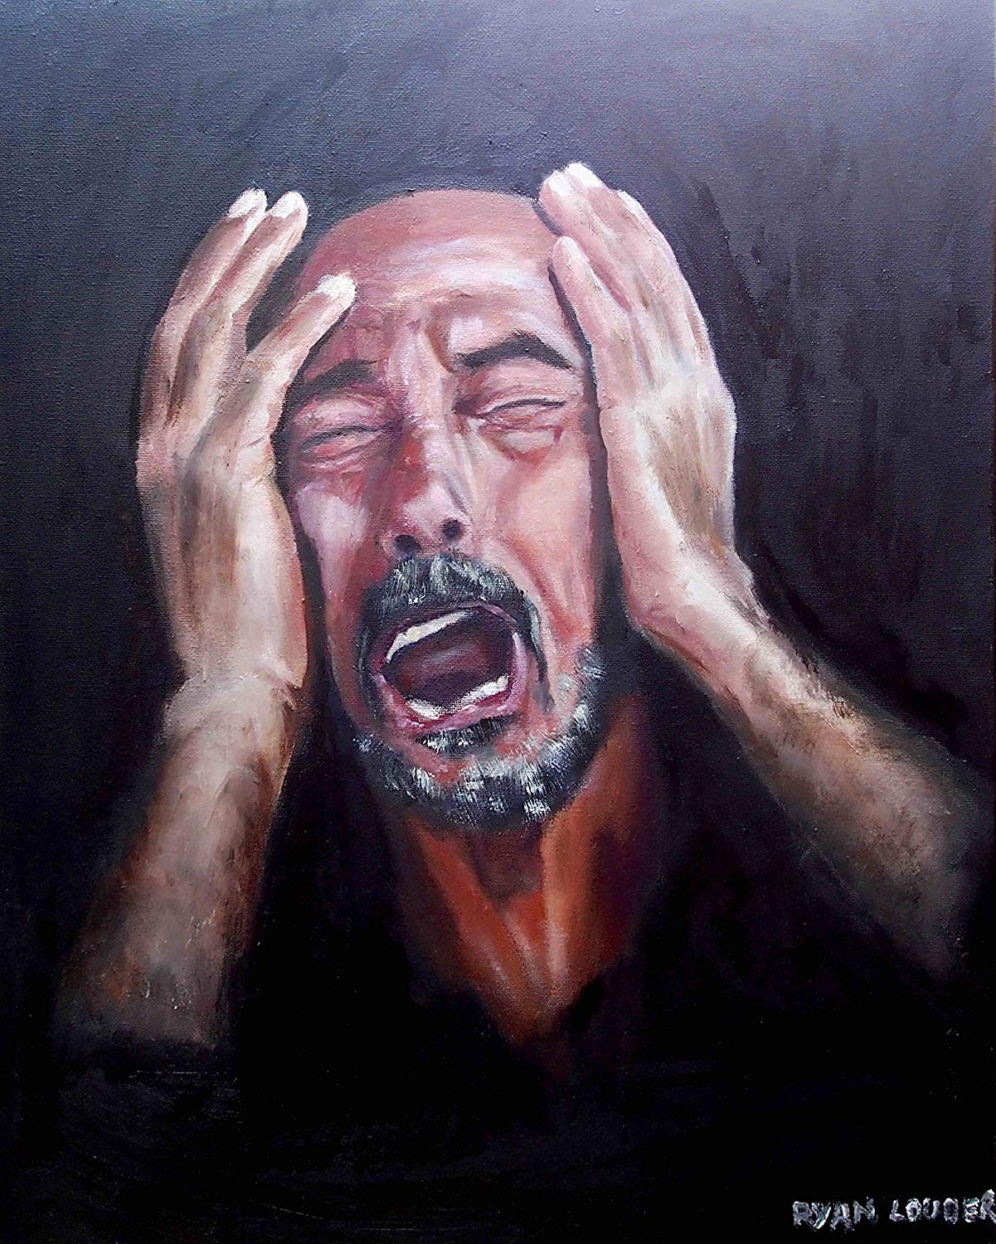
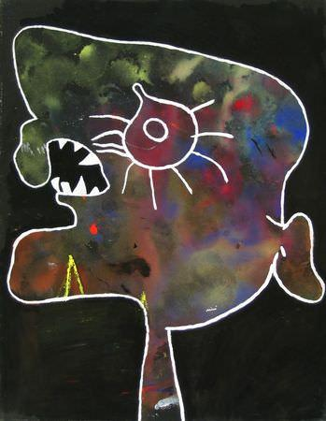
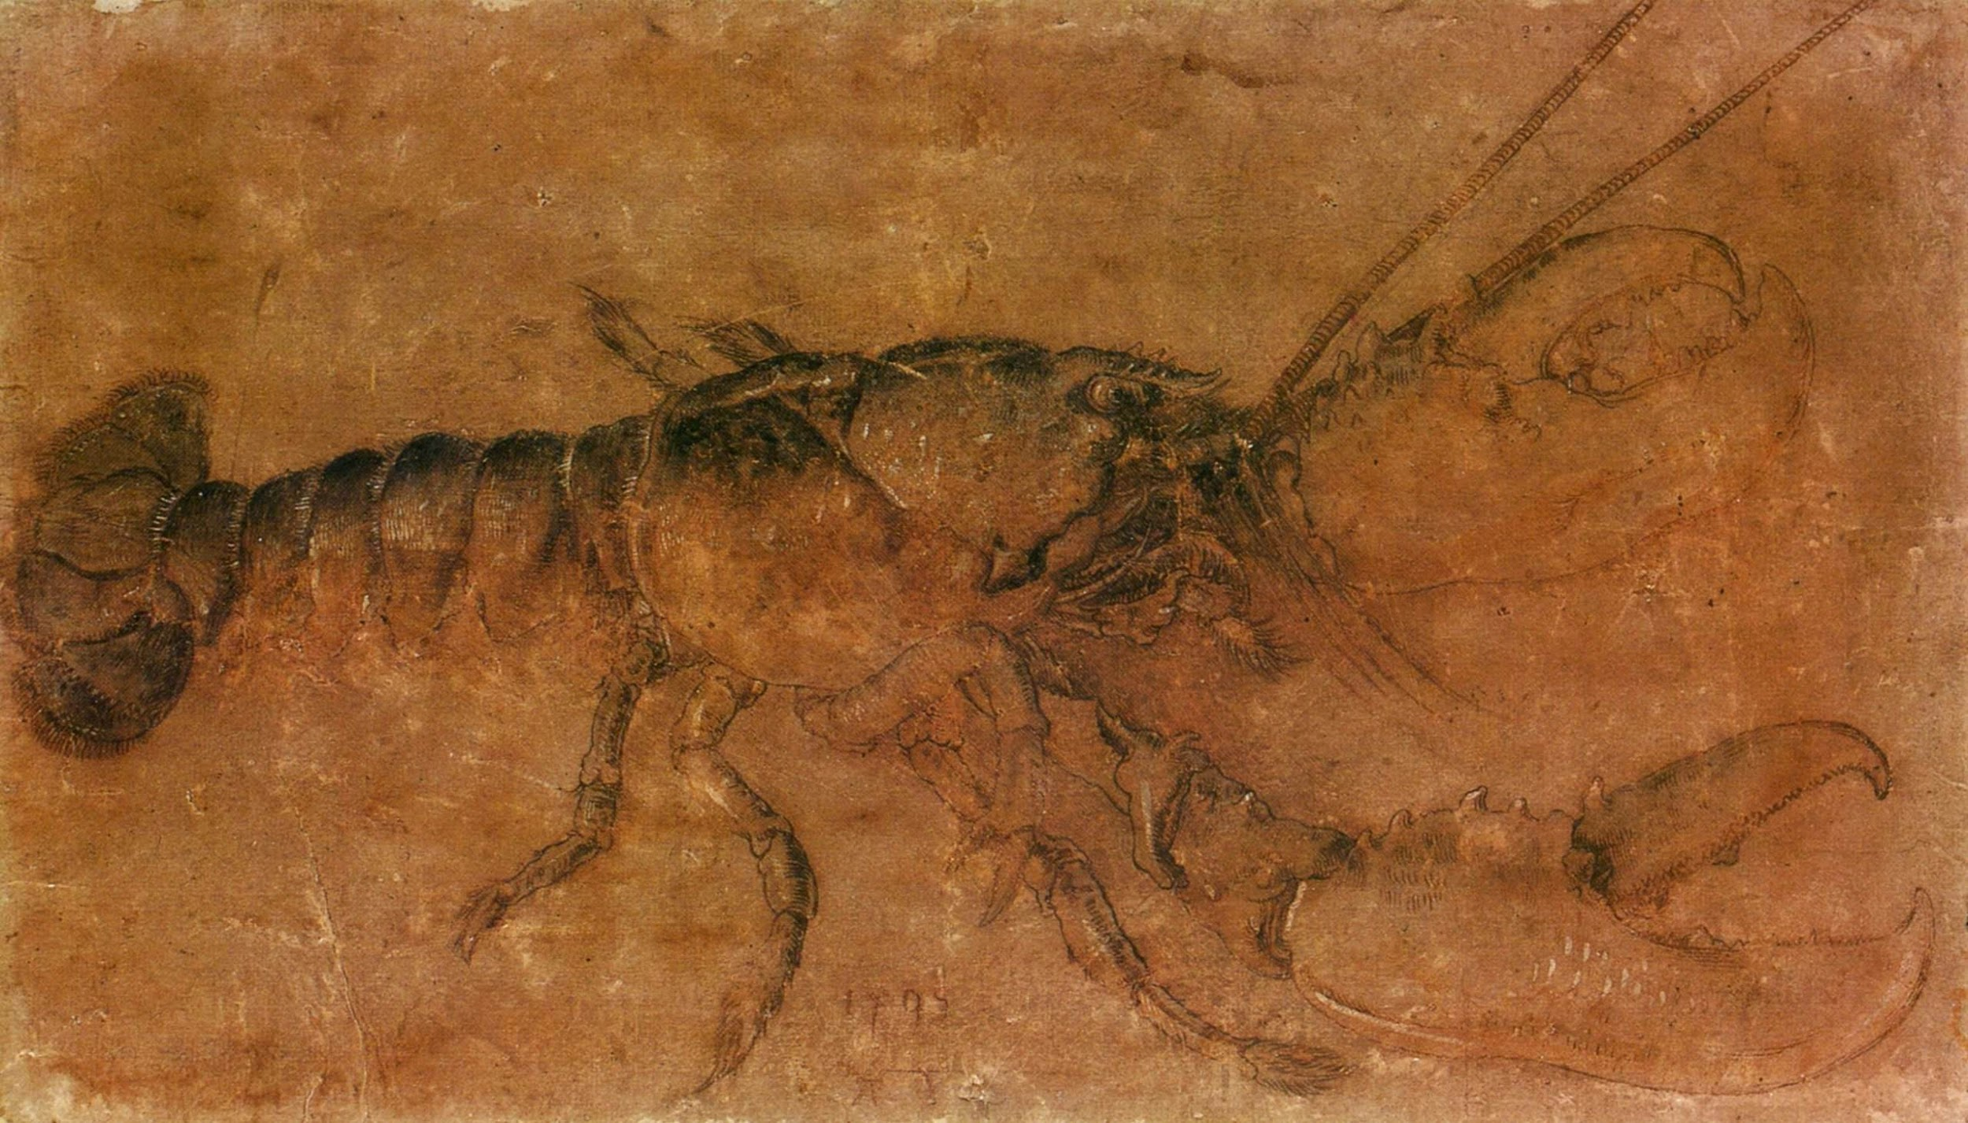
Art Classification with Convolutional Neural Networks
Tyler Buck and Stew LaPan

Slide 2
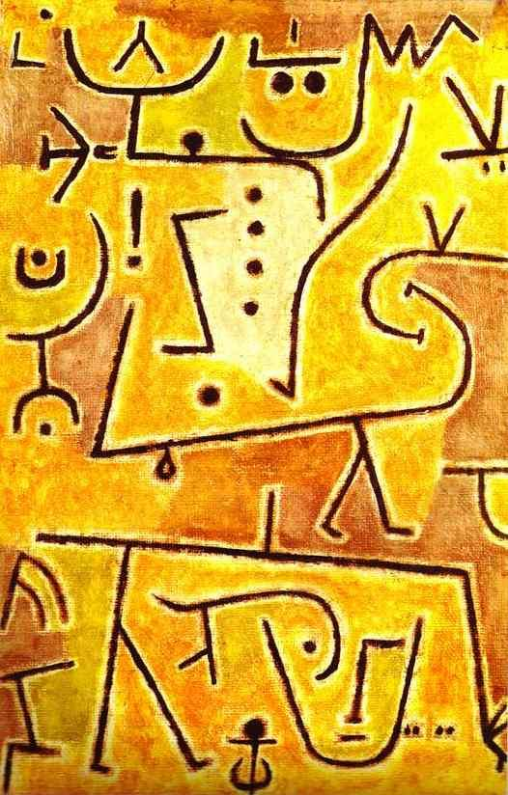
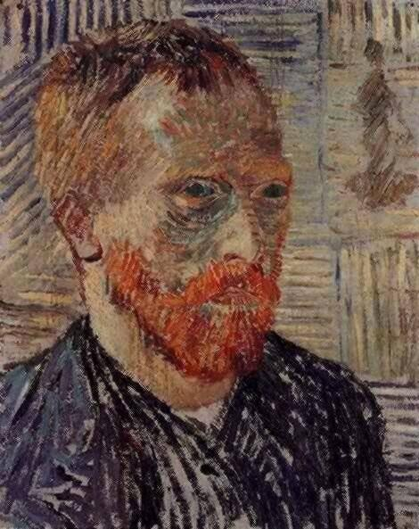
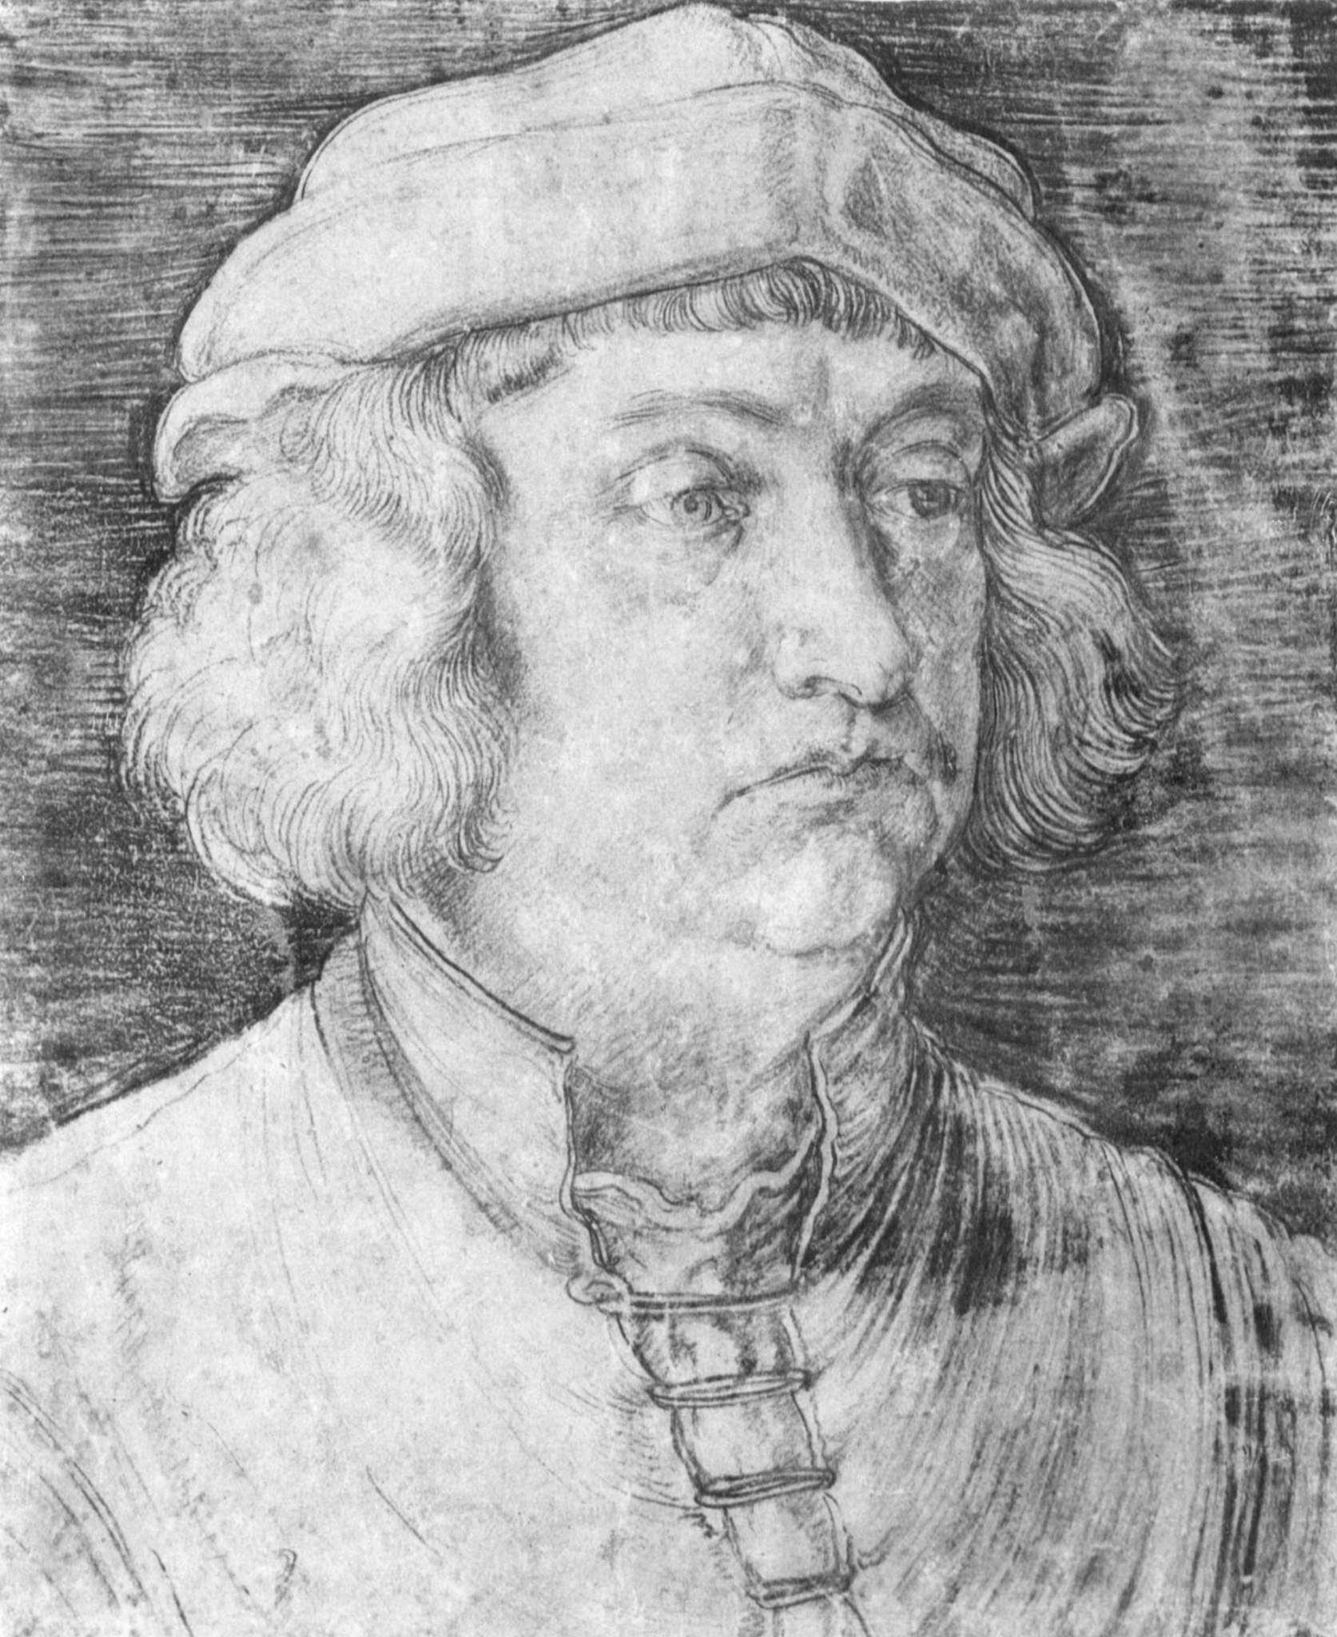
The Goal
Abstract Expressionism?
Art Nouveau?
Baroque?
Surrealism?
Symbolism?
...

Slide 3
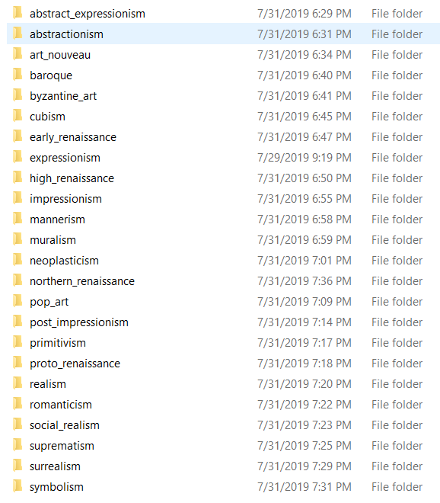
The Data
50 artists
24 styles
8,355 paintings

Slide 4
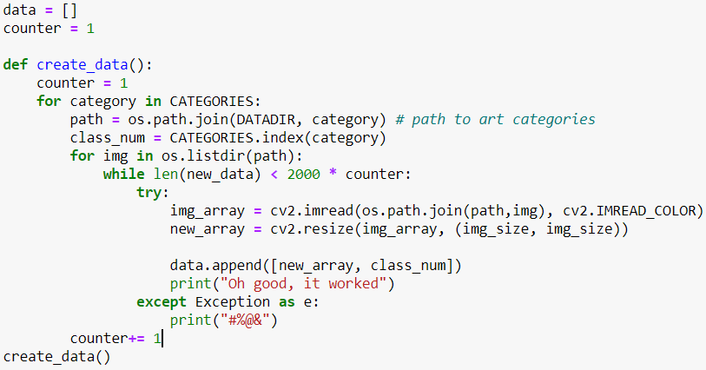
Pre-processing

Slide 5

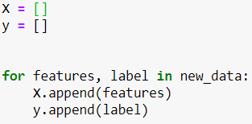

Pre-processing

Slide 6
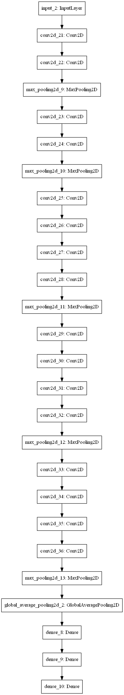
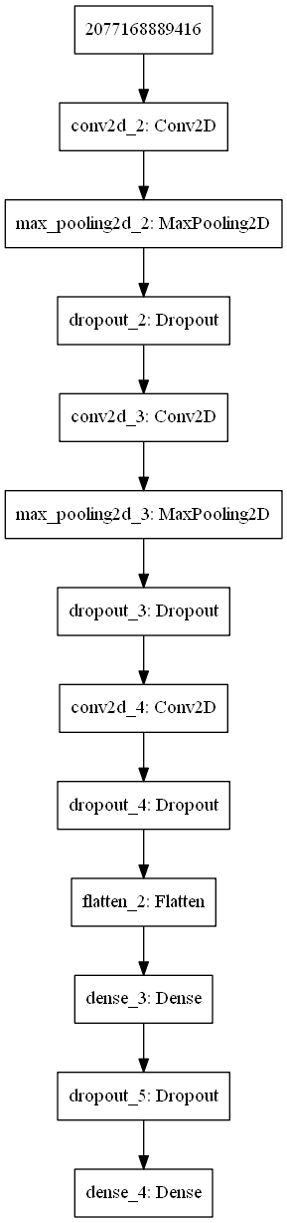
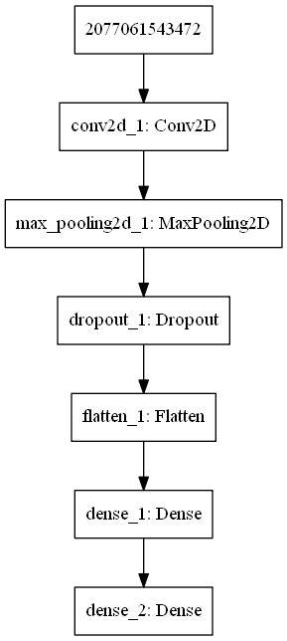
The Models

Slide 7






Layer Types
Basic spatial convolution
Prevents overfitting
Down-samples input, allows assumptions about sub-regions
Reshapes tensor to shape = # of elements - batch dimension
Densely connected layer

Slide 8
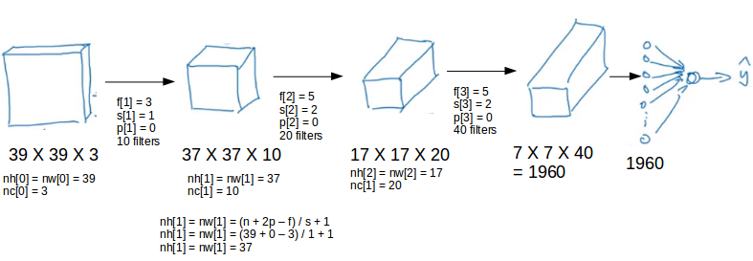

Slide 9
Hyper-parameters
# feature maps
Window Size
Stride
Padding

Slide 10
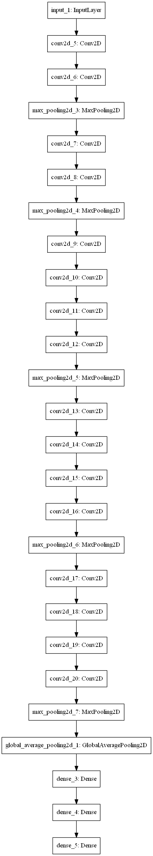
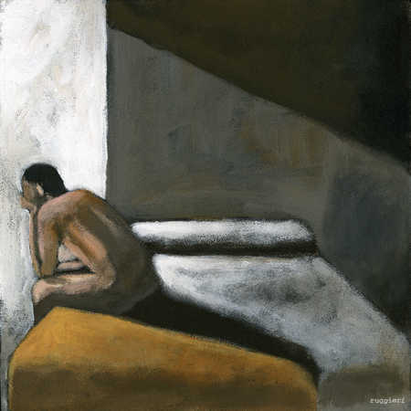
Results
Model Loss: 13.174
Model accuracy: 0.183

Slide 11
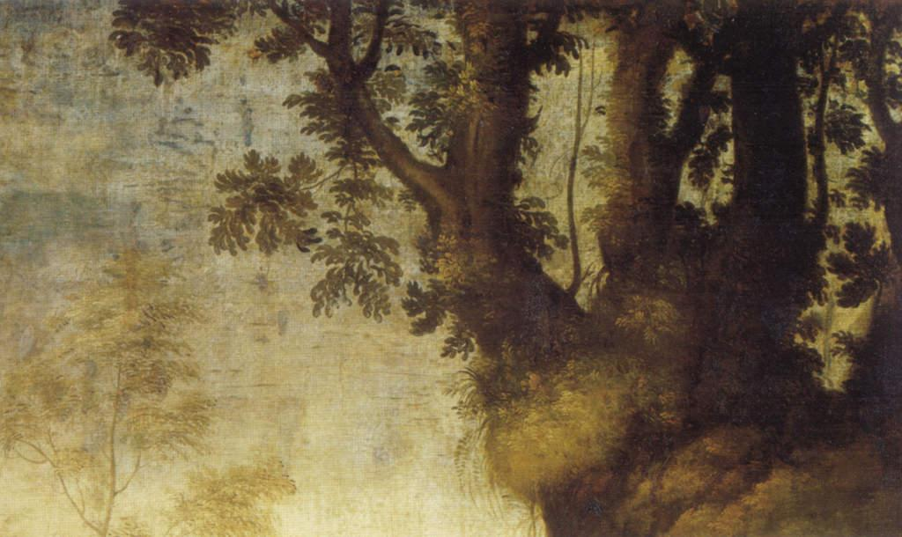
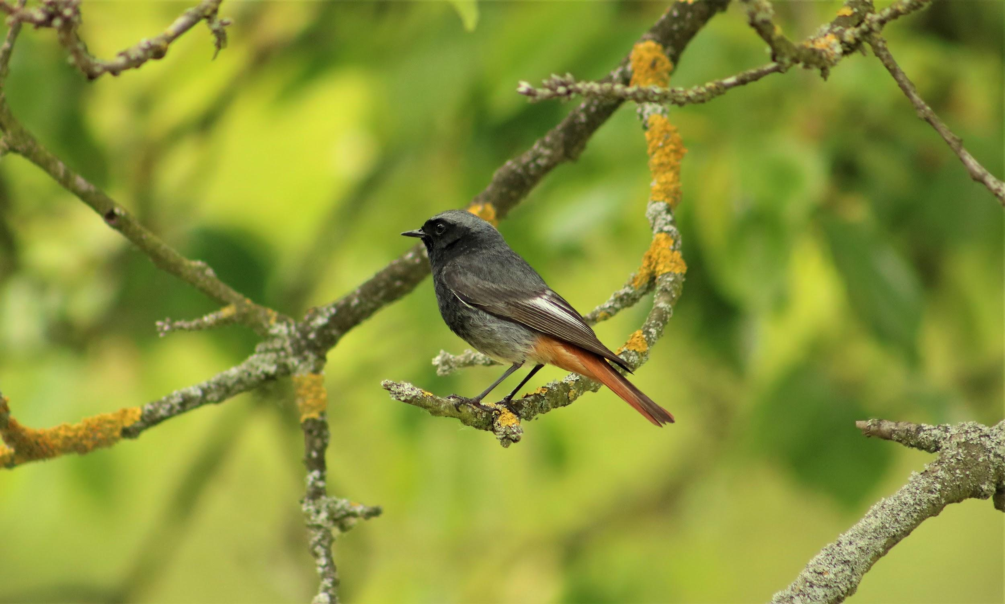
The Backup Plan

Slide 12
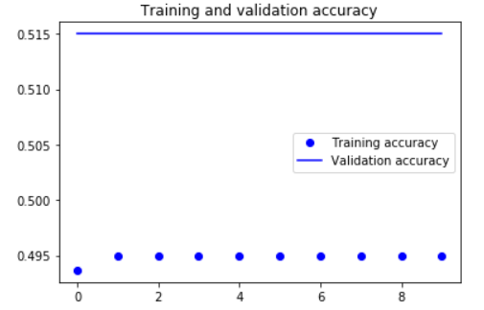
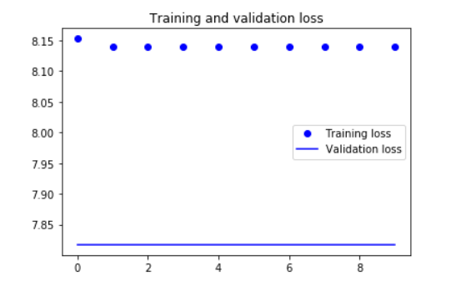
Results
Model Loss: 7.817
Model Accuracy: 0.515
 | Predicted Photo | Predicted Painting
True Photo | TN = 0 | FP = 485
True Painting | FN = 0 | TP = 515

Slide 13
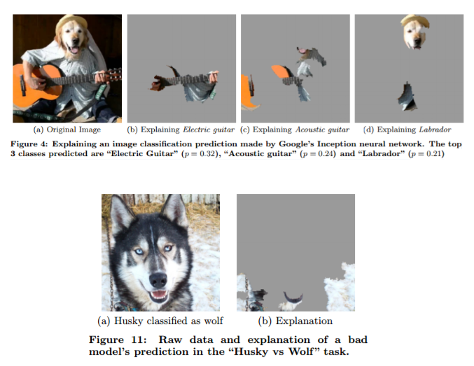
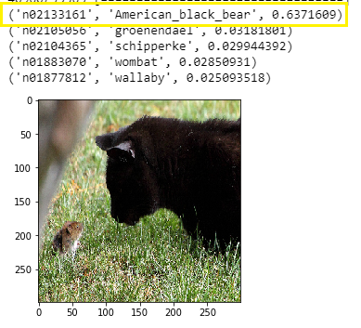
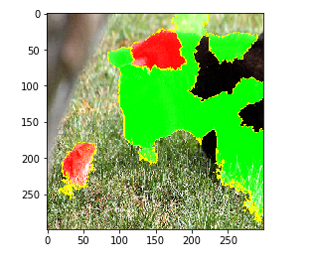
LIME (Local Interpretable Model-agnostic Explanations)

Slide 14
LIME: The Code (VGG19)
Dependencies
Explanation
import os
import numpy as np
import matplotlib.pyplot as plt
import tensorflow as tf
import keras
from keras.preprocessing import image
from keras.applications.vgg19 import (
VGG19,
preprocess_input,
decode_predictions
)
import lime
from lime import lime_image
from skimage.io import imread
from skimage.segmentation import mark_boundaries
explainer= lime_image.LimeImageExplainer()
explanation = explainer.explain_instance(
image_test[0],
model.predict,
top_labels=5,
hide_color=None,
num_samples=100
)
Notes:
VGG19 model - This is the first pre-trained model we used in class.

Slide 15
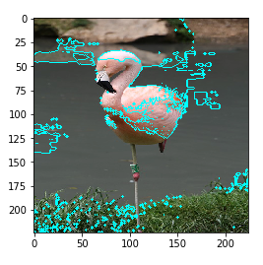
LIME: The Code (VGG19)
Plot Image and Boundaries
image_path = os.path.join("..", "Images", "bird1.jpg")
image_size = (224, 224)
img= image.load_img(
image_path,
target_size= image_size)
temp, mask= explanation.get_image_and_mask(
explanation.top_labels[0],
positive_only= True,
num_features= 20,
hide_rest= False
)
plt.imshow(
mark_boundaries(
img,
mask,
color= (0,1,1)
)
)
Preprocessing
def make_image(image_path):
img = image.load_img(
image_path,
target_size=image_size
)
x = image.img_to_array(img)
x = np.expand_dims(x, axis=0)
x = preprocess_input(x)
return x
Notes:
VGG19 model - This is the first pre-trained model we used in class.
get_image_and_mask()
Top_labels (“flamingo”)
Positive_only= True: Shows only Pros (False shows cons as well, i.e. the mouse in the cat pic)
Num_features: Increases how many boundaries are shown
Hide_rest: returns empty image for unexplained portions

Slide 16
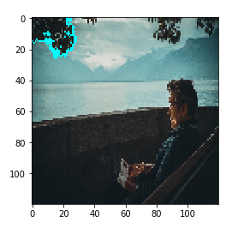
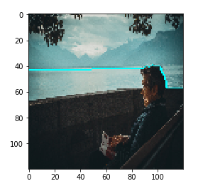

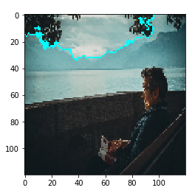
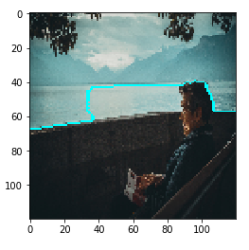
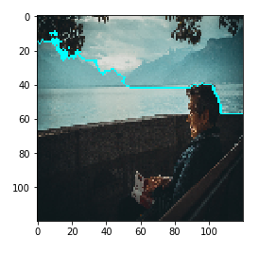
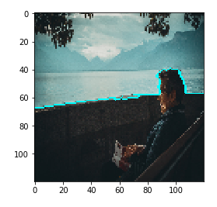
LIME: (Custom Model)
Notes:
VGG19 model - This is the first pre-trained model we used in class.

Slide 17
Citations
LIME Github: https://github.com/marcotcr/lime
U Washington Paper: https://arxiv.org/pdf/1602.04938.pdf
Photo provider: https://unsplash.com/
Paintings provider: https://www.kaggle.com/ikarus777/best-artworks-of-all-time

